Slide 1


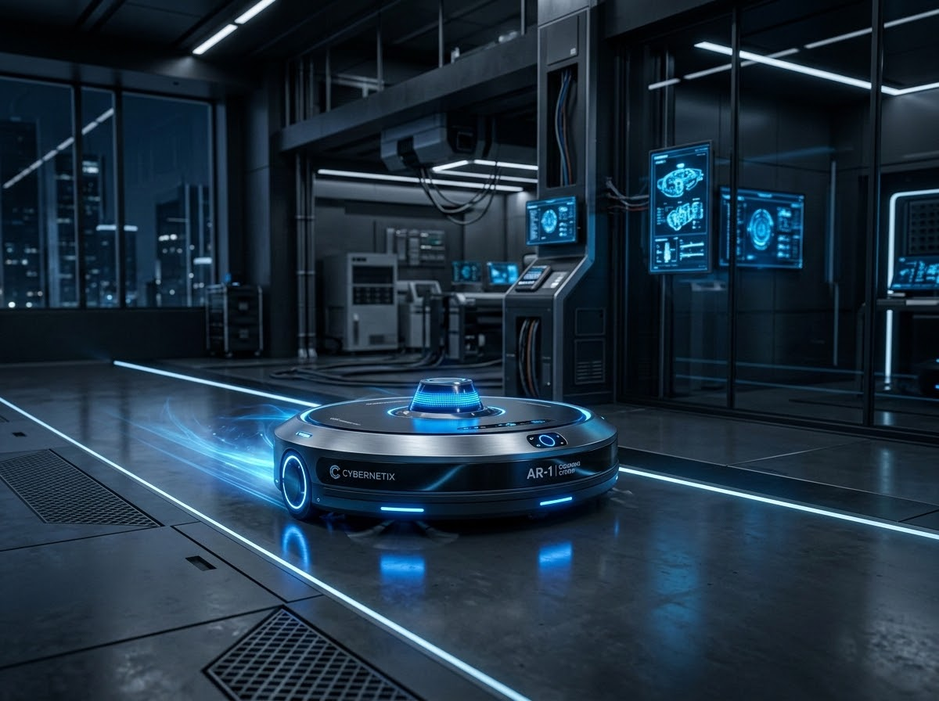
Autonomous Cleaning Strategy Planner: AI-Based Path Planning for Cleaning Robots
Research Team
K.V KOUSHAL (Roll No: 2520030009)
Y.CHARAN SAI (Roll No: 2520030173)
MAHANKALI SAI TARUN (Roll No: 2520090020)
Department
Computer Science & Engineering
Autonomous Cleaning Strategy Planner

Slide 2
Intelligent Decision-Making Automates Indoor Cleaning and Reduces Human Effort
Automate indoor cleaning tasks
Improve efficiency through intelligent decision-making
Maximize area coverage while avoiding obstacles
Demonstrate practical applications of AI
Intelligent decision-making architecture
Our primary goal is to significantly reduce human effort and cleaning time through high-fidelity automation.
Autonomous Cleaning Strategy Planner

Slide 3




A Hybrid AI Architecture Integrates Search Algorithms and Constraint Satisfaction
BFS / UCS / A*
Greedy Search
Heuristic Functions
Obstacle Avoidance
Autonomous Cleaning Agent
Utility Decision Making
Path Planning
Hybrid Architecture
Search Visalization
Autonomous Cleaning Strategy Planner

Slide 4
